Slide 1
ADI/CU GP 2025/2026
Progress Update Meeting (2)
Part (1) : Accelerated FFT task
Front end team …..

Slide 2
Agenda
HW/SW Co-design (HW Part)
HW/SW Co-design (SW Part)

Slide 3
HW/SW Co-design (HW Part)

Slide 4
Agenda
HW/SW Co-design
Problem Statement
Butterfly Operation
RTL Design
Arithmetic Optimization
Pipeline Alignment
PULP Integration
Wrapper Architecture
SoC Modifications
Software & Verification (1)
Optimizations
Software & Verification (2)

Slide 5
HW/SW Co-design : Problem Statement
Objective:
Integrate a custom-designed Radix-2 FFT Butterfly hardware accelerator into the PULP platform as an AXI peripheral and drive it with a complete software FFT implementation.
Goal:
Validate correct hardware/software interaction.
Scope of current work:
Hardware Scope:
RTL of radix-2 Butterfly, Map the standalone butterfly accelerator to the AXI bus, design the protocol translation wrapper, and a simple Software validation using a simple C test.
Software Scope:
Invoke butterfly by the SW FFT
Problem Statement
Arithmetic Optimization
Butterfly Operation
RTL Design
Pipeline Alignment
PULP integration
Wrapper Architecture
SoC Modifications
Software & Verification

Slide 6
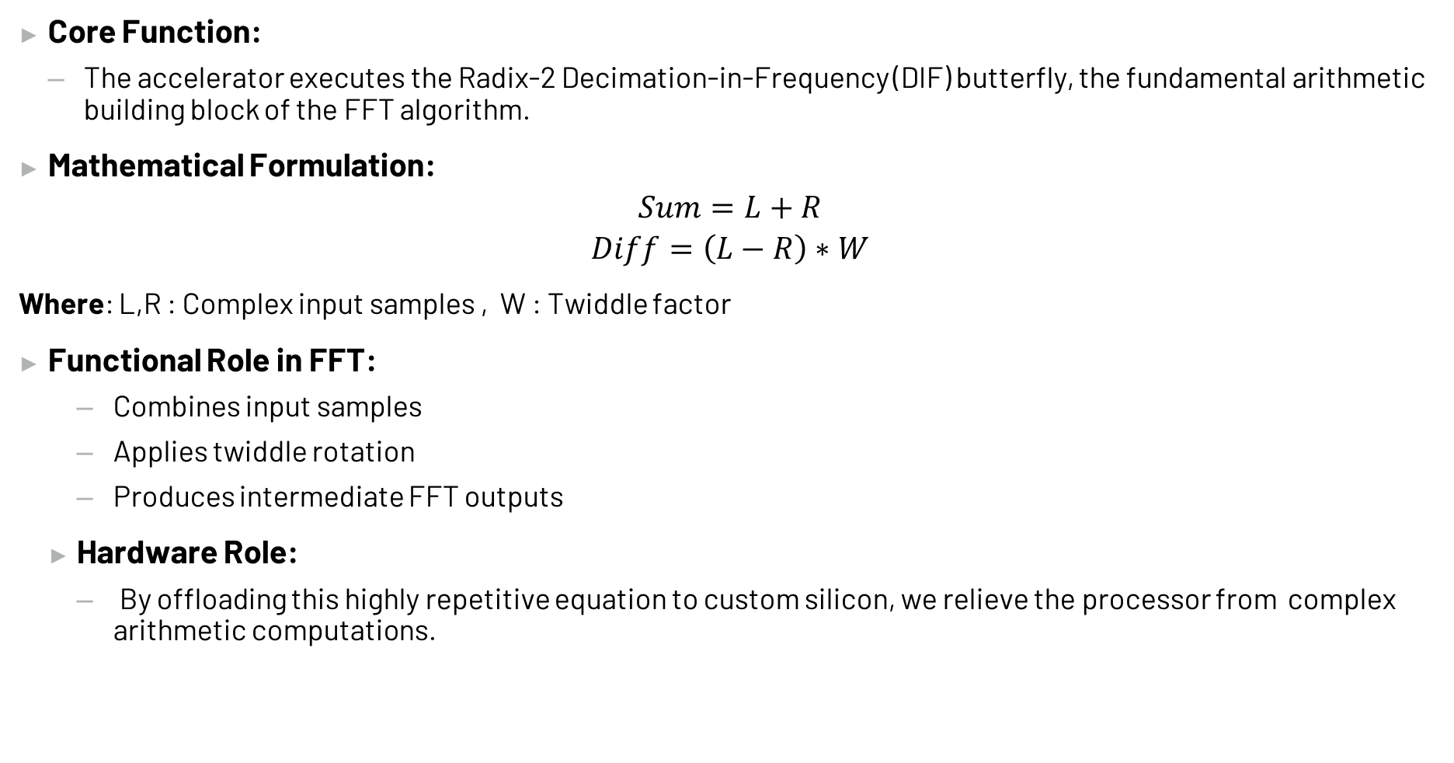
HW/SW Co-design : Butterfly Operation
Core Function:
The accelerator executes the Radix-2 Decimation-in-Frequency (DIF) butterfly, the fundamental arithmetic building block of the FFT algorithm.
Mathematical Formulation:
$$Sum=L+R$$
$$Diff=\left(L−R\right)∗W$$
Where: L,R : Complex input samples , W : Twiddle factor
Functional Role in FFT:
Combines input samples
Applies twiddle rotation
Produces intermediate FFT outputs
Hardware Role:
By offloading this highly repetitive equation to custom silicon, we relieve the processor from complex arithmetic computations.
Problem Statement
Arithmetic Optimization
Butterfly Operation
RTL Design
Pipeline Alignment
PULP integration
Wrapper Architecture
SoC Modifications
Software & Verification

Slide 7
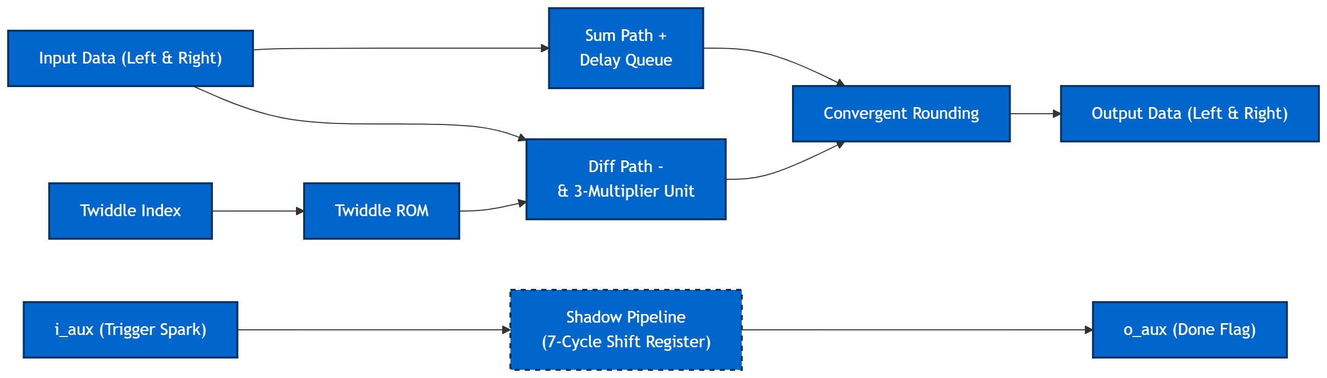
HW/SW Co-design : RTL Design
Core blocks:
Add/Subtract Units
Karatsuba Multiplier
Pipeline / Delay Alignment
Supporting Modules Originally:
bimpy
Base signed multiplier
Longbimpy
Supports larger operand widths
Currently Used
standard multiplication logic
Problem Statement
Arithmetic Optimization
Butterfly Operation
RTL Design
Pipeline Alignment
PULP integration
Wrapper Architecture
SoC Modifications
Software & Verification

Slide 8
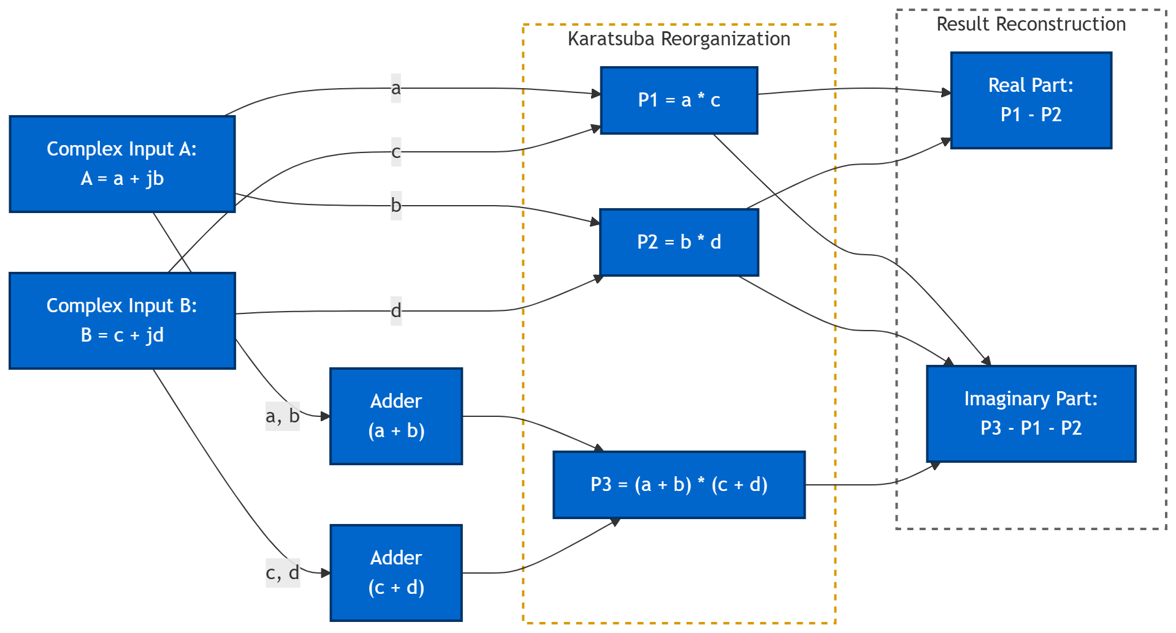
HW/SW Co-design : Arithmetic Optimization
The Hardware Challenge:
Complex multiplication is the most expensive operation in our entire Datapath.
A standard complex multiply requires 4 real multipliers.
The Optimization : Karatsuba Algorithm
Reformulated the multiplication logic. we complete the math using only 3 real multipliers.
Benefits:
Reduced multiplier count
Lower hardware area and power
The Price:
This approach requires adding extra Adders.
Problem Statement
Arithmetic Optimization
Butterfly Operation
RTL Design
Pipeline Alignment
PULP integration
Wrapper Architecture
SoC Modifications
Software & Verification

Slide 9
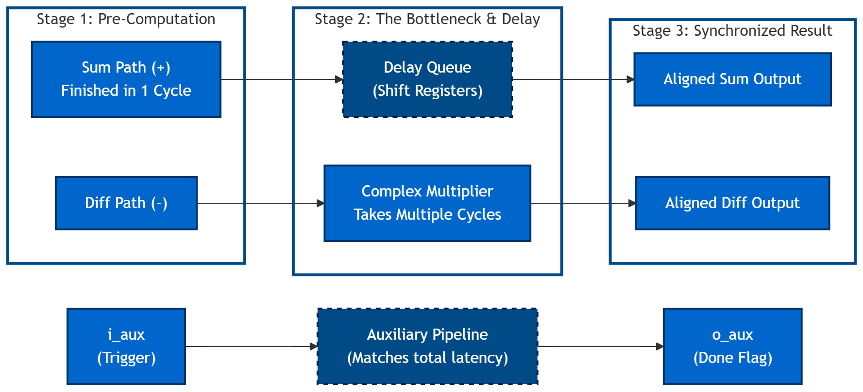
HW/SW Co-design : Pipeline Alignment
Motivation:
Multiplier introduces computation latency
Addition path is faster
Outputs must remain time-aligned
Implemented Solution:
Auxiliary Signal Propagation
Result:
The faster mathematical path is delayed to match the slower paths, ensuring the Sum and Difference outputs are aligned.
Problem Statement
Arithmetic Optimization
Butterfly Operation
RTL Design
Pipeline Alignment
PULP integration
Wrapper Architecture
SoC Modifications
Software & Verification

Slide 10
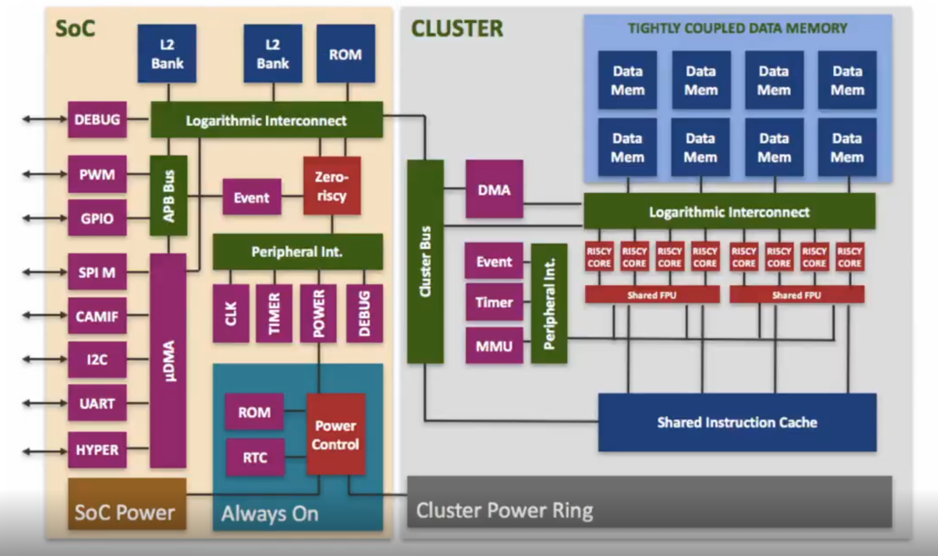
HW/SW Co-design : PULP Intergation
Objective:
Expose the butterfly accelerator as a memory-mapped AXI peripheral within the PULP SoC.
Pulp Architecture Overview
The TCDM:
Normal processors rely on invisible memory caches, which cause unpredictable delays.
PULP replaces caches with a Tightly Coupled Data Memory (TCDM)—a shared, ultra-fast scratchpad where Software must explicitly place data into the TCDM.
The System Actors:
Fabric Controller
Micro-DMA
Accelerators
Problem Statement
Arithmetic Optimization
Butterfly Operation
RTL Design
Pipeline Alignment
PULP integration
Wrapper Architecture
SoC Modifications
Software & Verification

Slide 11
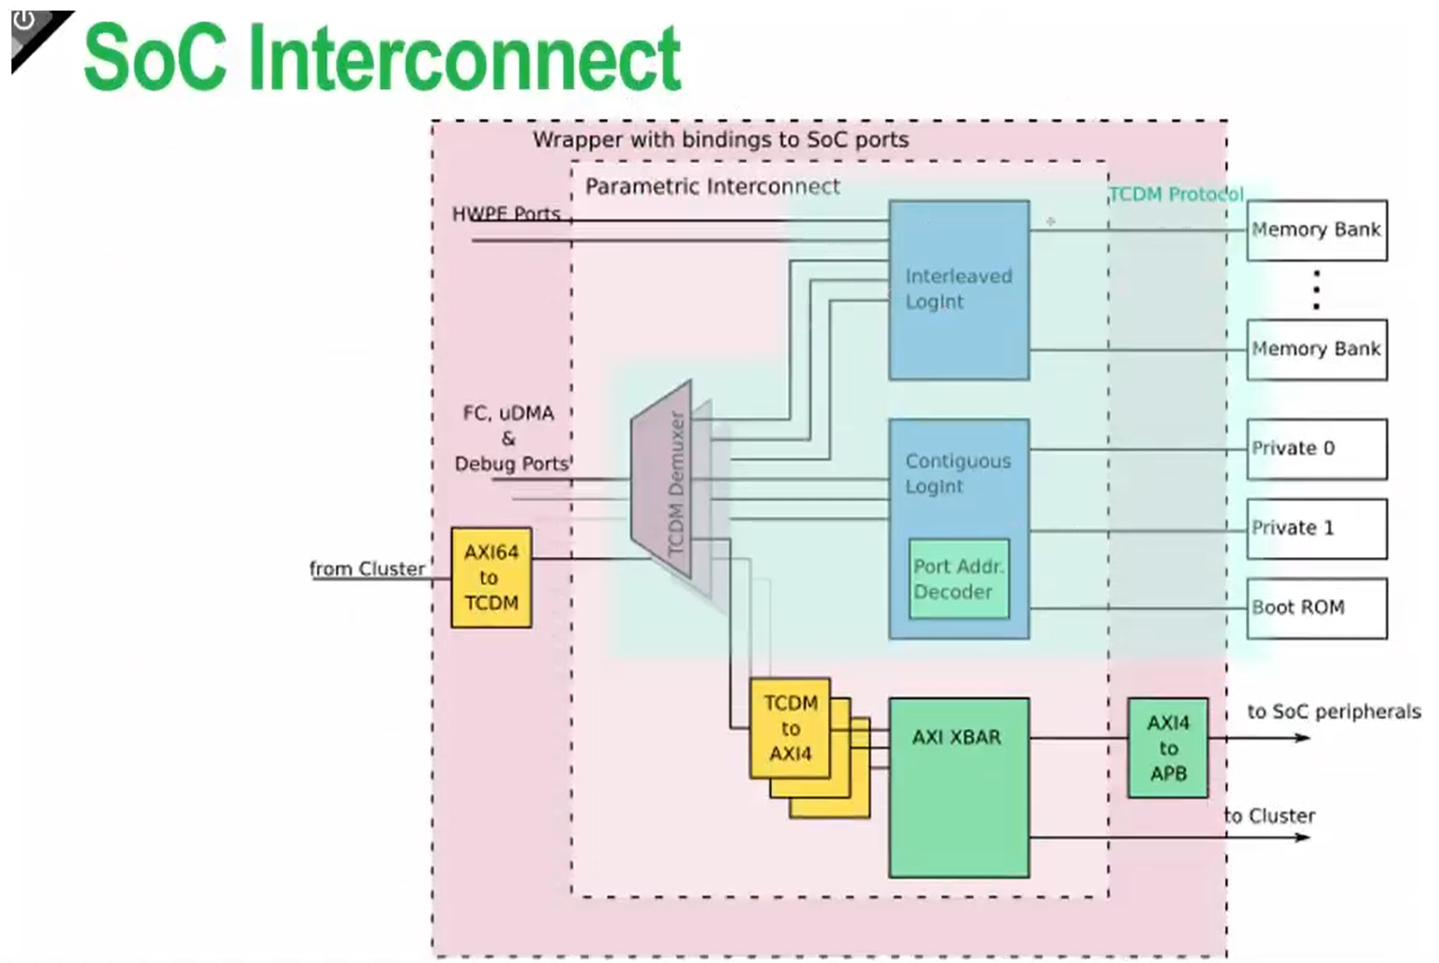
HW/SW Co-design :Highway System – Interconnects and Arbitration
Two Separate Traffic Networks:
TCDM Interconnect: reserved for fast operations, 1-cycle memory lookups.
AXI Crossbar: Built for complex components that needs multiple cycles.
How Software Talks to Hardware:
Address-Based Routing: Hardware doesn't have a name, only a memory address.
Two Paths of Communication:
The Control Path :The FC configures the hardware by writing values to these addresses.
The Data Path: Pushing the heavy payloads to the hardware so it can begin computation.
Wrapper
Accelerator
Problem Statement
Arithmetic Optimization
Pipeline Alignment
Butterfly Operation
RTL Design
PULP integration
SOC-Interconnect
Wrapper Architecture
Software & Verification

Slide 12
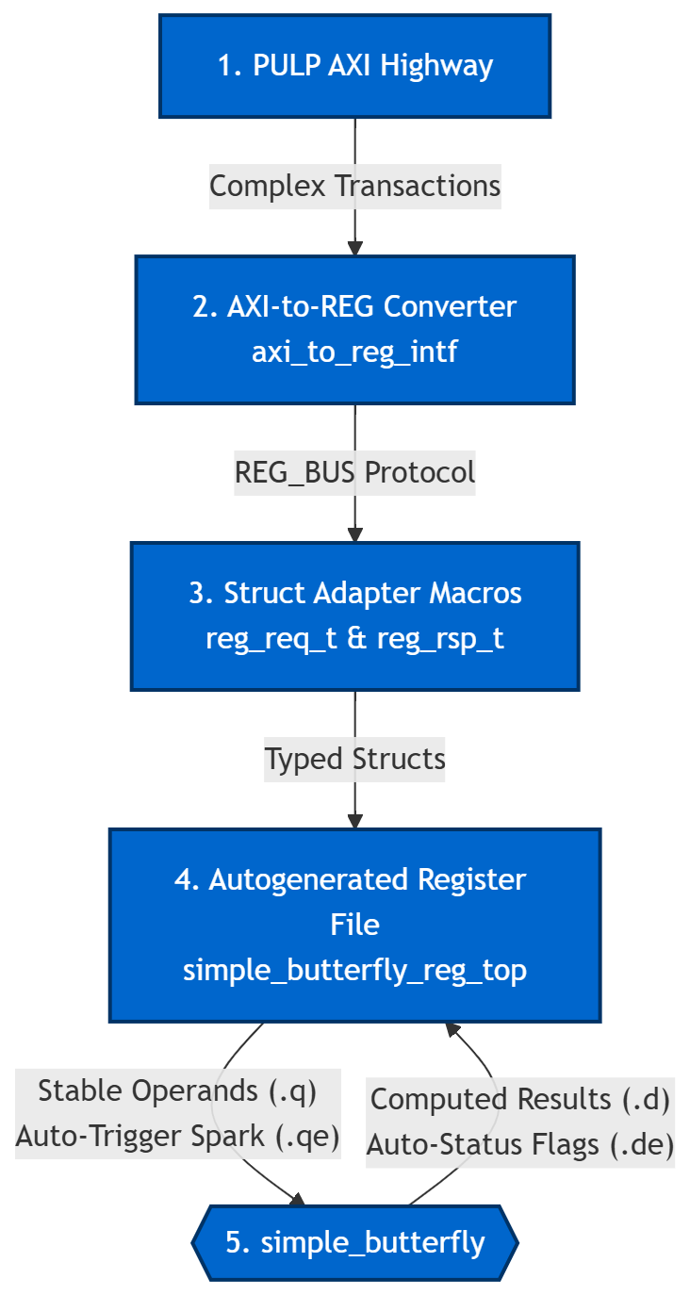
HW/SW Co-design : The Translation Wrapper
The Problem: AXI is Too Complex
Our custom accelerator doesn't know how to speak the complex AXI handshaking protocol.
Solution
Translate bus transactions into register-level control via wrapper
The Blueprint (The .hjson file)
A "contract" between software and hardware.
The Protocol Downgrade :
AXI → Protocol Converter → REG_BUS
REG_BUS → Macros → Structs
The Hardware Reality (.q , .qe, .d, .de) :
The auto-generated register file unpacks those Structs into raw electrical wires:
.q : Stable Data, .qe: The Spark (1-cycle trigger pulse)
.d : The Results from the hardware , .de : Data Enable.
Problem Statement
Arithmetic Optimization
Butterfly Operation
RTL Design
Pipeline Alignment
PULP integration
Wrapper Architecture
SoC Modifications
Software & Verification

Slide 13
HW/SW Co-design : Soc Modifications
Key Modifications:
Instantiated the top-level wrapper inside the pulp_soc.sv.
Added a dedicated AXI slave port to the system crossbar.
Extended the AXI interconnect routing logic to accommodate the new peripheral.
Updated the global SoC address map to recognize the accelerator.
Address Allocation:
Assigned a dedicated memory-mapped region for the Butterfly IP.
Result:
The custom accelerator is now a fully visible, permanently integrated node on the system bus. It is accessible through standard AXI memory transactions.
Problem Statement
Arithmetic Optimization
Butterfly Operation
RTL Design
Pipeline Alignment
PULP integration
Wrapper Architecture
SoC Modifications
Software & Verification

Slide 14
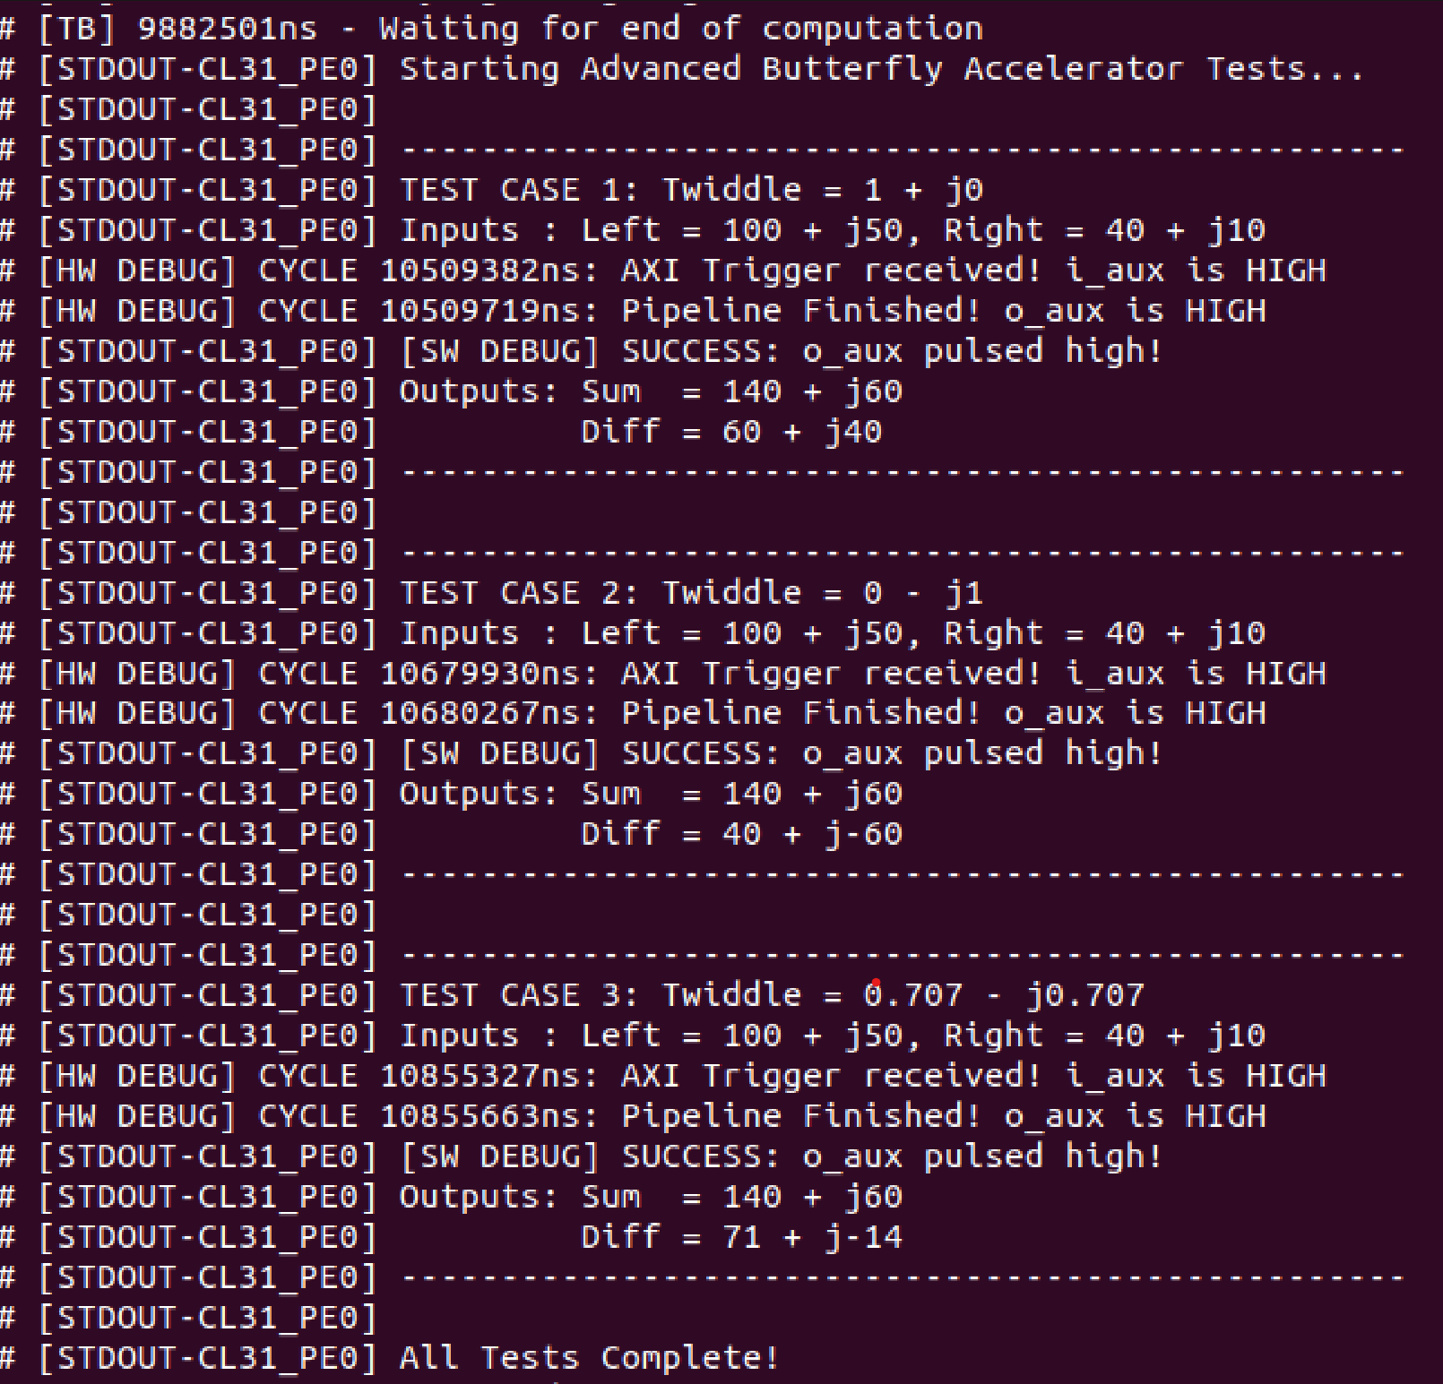
HW/SW Co-design : Software & Verification (1)
Step 1: Verify Integration &Mathematical Correctness
Results Match the results from the Written Testbench
Software Control:
Simple Custom C test application developed
Execution Flow:
Write inputs to registers
Trigger accelerator
Poll DONE status
Read computed outputs
Observed Results:
Correct butterfly arithmetic
Successful HW/SW communication
Measured Latency For Original butterfly was 442 cycle!!
Problem Statement
Arithmetic Optimization
Butterfly Operation
RTL Design
Pipeline Alignment
PULP integration
Wrapper Architecture
SoC Modifications
Software & Verification

Slide 15
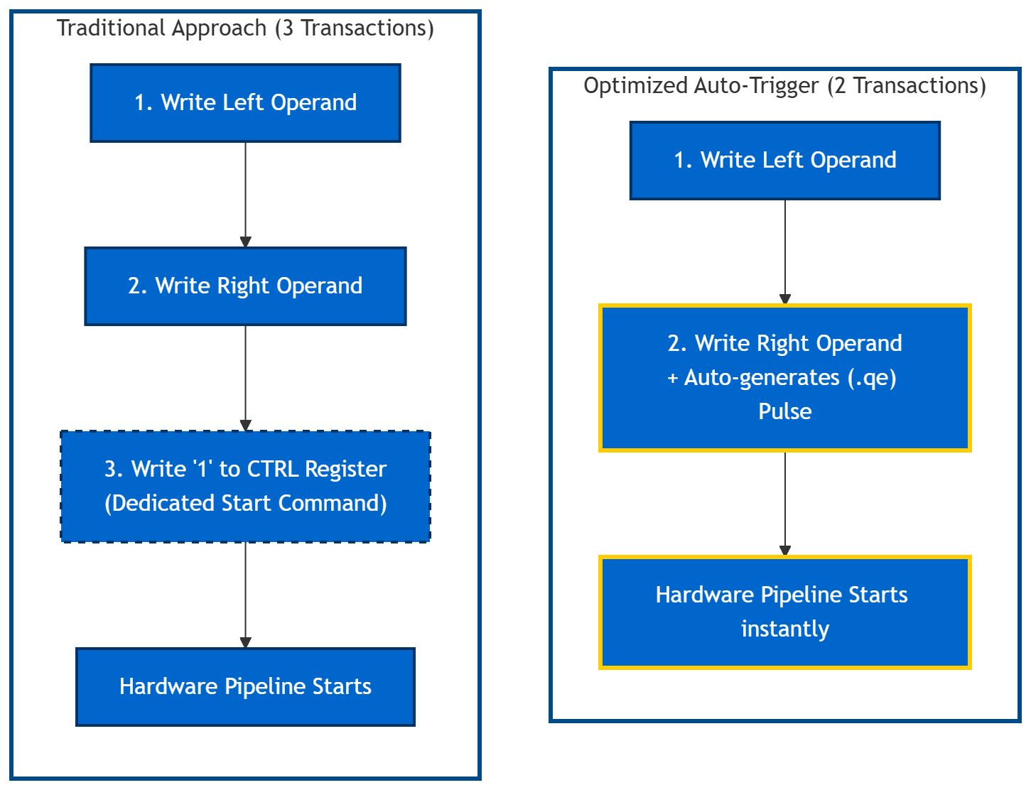
HW/SW Co-design : Optimization 1 – The Auto-Trigger
The Traditional Approach (3 Bus Transactions):
Software writes the Left Operand.
Software writes the Right Operand.
Software writes a '1' to a CTRL register to wake up the hardware.
Optimized Solution (2 Bus Transactions):
Eliminated the dedicated "Start" register.
Flagged the Right Operand register to generate a Write-Enable pulse.
The Benefit:
The hardware instantly fires up instantly.
Saves AXI transaction on every single butterfly
Result:
Number of Cycles taken for the End-to-end Butterfly execution decreased.

Slide 16
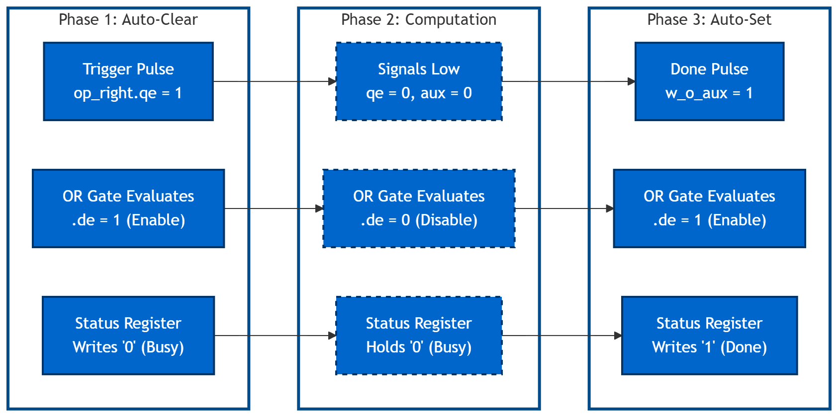
HW/SW Co-design : Optimization 2 – Auto-Status
The Polling Problem:
Software must manually clear this STATUS flag before new calculation, wasting an AXI transaction.
Solution (The .de Wire):
status.d = w_o_aux ? 1'b1 : 1’b0, status.de = w_o_aux | op_right.qe
Result:
Saved another AXI transaction. So,Number of Cycles taken for the End-to-end Butterfly execution decreased.

Slide 17
HW/SW Co-design : Software & Verification (2)
Step 2:Latency Profiling
Design Feature | Phase 1 (Pipelined) | Phase 2 (Pipelined) | Phase 3 (Pipelined) | Phase 4 (Flattened)
Operand Widths | Oversized: 34b In, 38b Out, 42b Twiddle | Corrected: 24b In, 24b Out, 32b Twiddle | Corrected: 24b In, 24b Out, 32b Twiddle | Corrected: 24b In, 24b Out, 32b Twiddle
Twiddle Delivery | Full payload passed over AXI | Full payload passed over AXI | Twiddle Index passed over AXI | Twiddle Index passed over AXI
Wrapper | No optimizations | No optimizations | optimized | optimized
Multiplier Type | Pipelined | Pipelined | Standard | Standard
Software Driver | High Overhead | Optimized | Optimized | Optimized
Latency | 442 cycles | 59 cycles | 24 cycles | 24 cycles

Slide 18
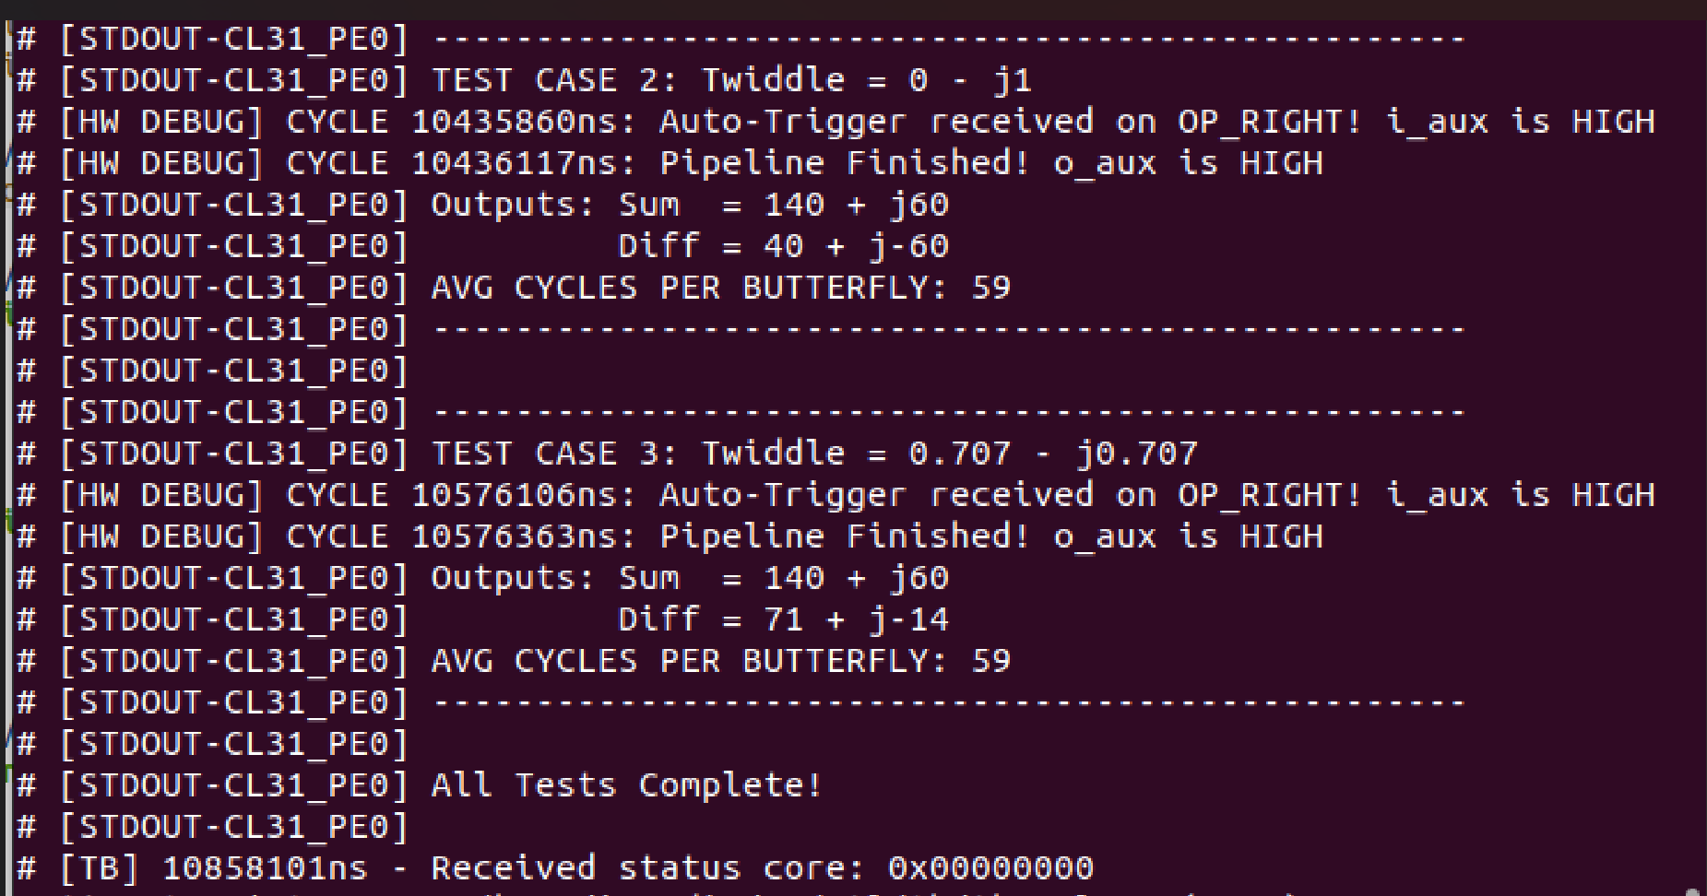
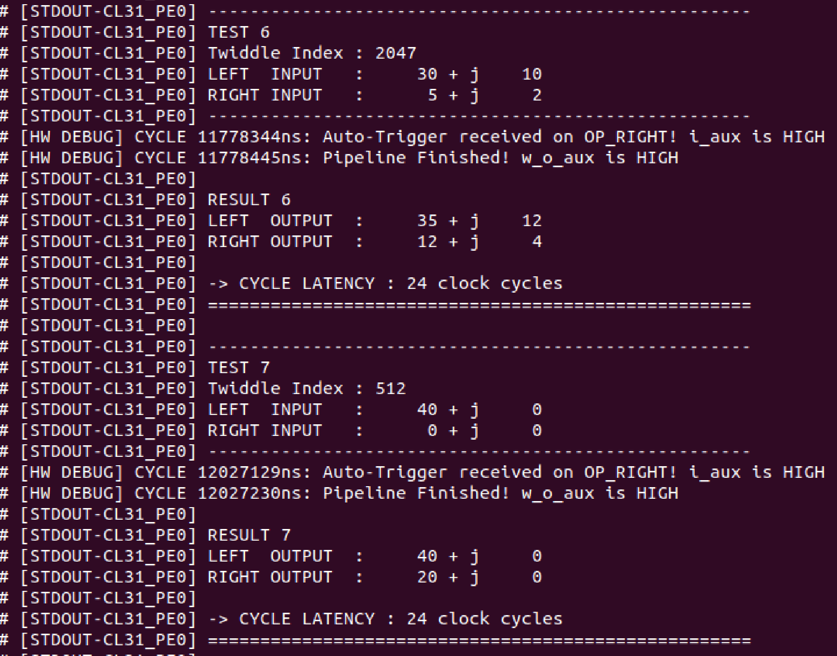
HW/SW Co-design : Software & Verification (2)
Step 2:Latency Profiling
Phase 2: Result
Phase 3: Result

Slide 19
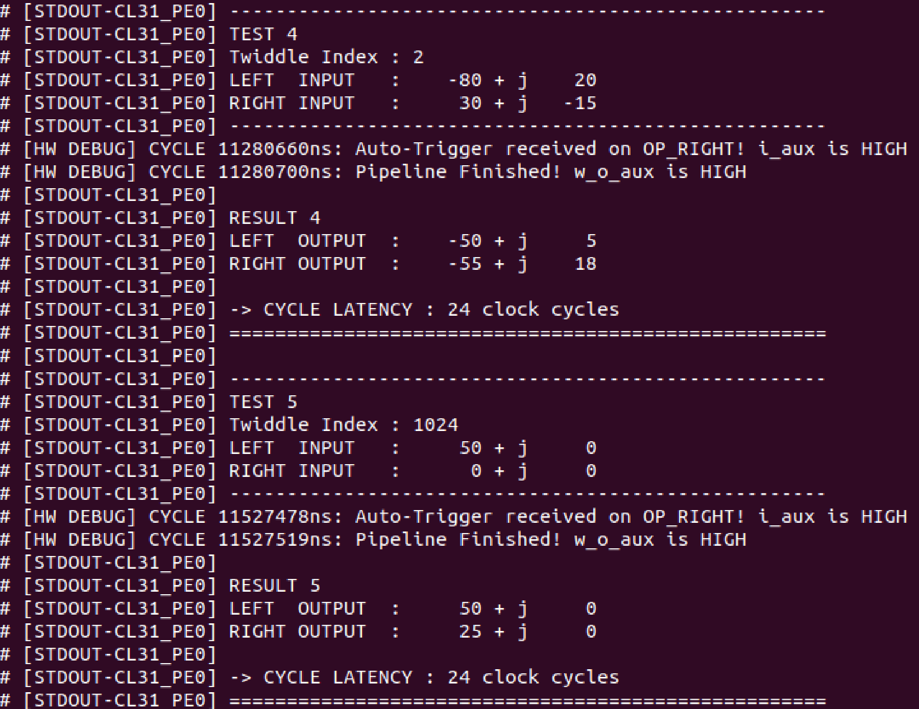
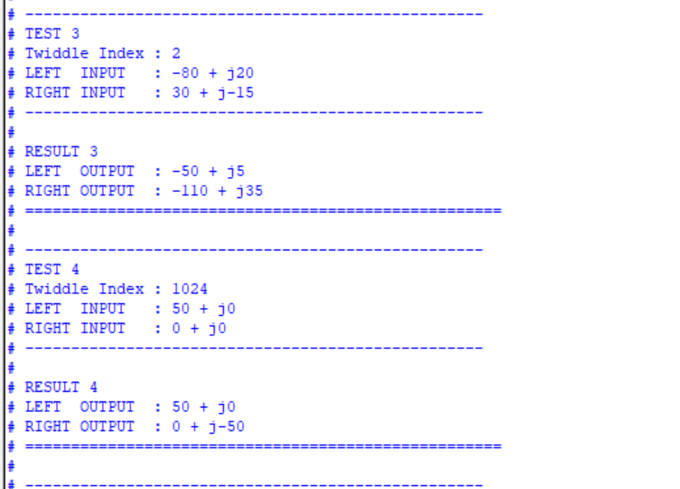
HW/SW Co-design : Software & Verification (2)
Step 2:Latency Profiling
Phase 4: Result
Testbench result

Slide 20
GitHub Repositories
1- MATLAB modeling code for SDF DIF : (Modeling part by Mostafa Fathy)
https://github.com/Mostafa-Yossry/ADI-CU-GP-2025-2026/tree/main/System-Modelling/SDF-Radix2-FFT
2- SDF 4092-point code : (RTL part by Marwan Khaled and Mostafa Fathy)
https://github.com/Mostafa-Yossry/ADI-CU-GP-2025-2026/tree/main/RTL/FFT_SDF
3- Source code can be found here: (Firmware part by Mostafa Yossry) https://github.com/Mostafa-Yossry/ADI-CU-GP-2025-2026/tree/main/Firmware/Radix2-FFT 4- RTL implementations and Wrapper codes can be found here: (AXI integration part by Mostafa Ahmed)
https://github.com/Mostafa-Yossry/ADI-CU-GP-2025-2026/tree/main/RTL/simple_butterfly/simple_butterfly

Slide 21
References
Mr.Wolf: An Energy-Precision Scalable Parallel Ultra Low Power SoC for IoT Edge Processing:
https://pulp-platform.org/docs/publications/08715500.pdf [1]
Fast Fourier Transform :Algorithms And Applications)
https://danylastchild07.wordpress.com/wp-content/uploads/2016/05/fft_algorithms-and-applications.pdf
VLSI Digital Signal Processing Systems: Design and Implementation
https://d1.amobbs.com/bbs_upload782111/files_18/ourdev_480582.pdf
PULP platform
https://pulp-platform.org/index.html

Slide 22
Thank You!

